Slide 1
Cape Town BEPP – Addressing the backlogs and future demands for Social Amenities
Community Services

Slide 2
Presentation Overview
City Vision for Social Amenities
City plans and options
Current Situation
Facility backlogs and growing demand
Workshops /discussions
Financial realities
Questions

Slide 3
Addressing the backlogs and future demands for Social Amenities
Community Services (Sport Fields/Complexes, Recreation Centres, Multipurpose Centres, Halls, Parks, Libraries)
Our vision:
To provide social amenities on an equitable and sustainable basis across Cape Town to promote healthy lifestyles.
To optimise and rationalise social amenities on a continuous basis to ensure sustainability and alignment to current and future community needs.

Slide 4
Current Situation
According to the South African National Health and Nutrition Examination Survey (SANHANES) released on 6 August 2013, : "The Mother City knocked the socks off its rivals, offering its residents the greatest number of facilities (sports clubs, gyms, fitness amenities and recreational parks) per 100 000 people
Numerous facility provision awards

Slide 6
CSIR/BE/SPS/ER/2014/0060/B.2
Forward Planning 2032: Social Facilities in Cape Town
Integrated Social Facility Investment Priority Guide
(Product 5)
October 2014

Slide 7
Context
Scientific-based accessibility analysis exercise that assesses whether people have access to facilities, whether these facilities are within reasonable reach, and whether they’re able to accommodate future population growth
This project product generally highlights the social/ community facility demand pictures for 2032 from a City of Cape Town perspective.
Demand | 2007 projected population figures 2016 projected population figures 2032 projected population figures
Supply | For every 0.2 Ha of district park, 1 000 people are served
Travel mode and access time | Transport via existing road network: District parks must be accessed within 20 minute travel time by vehicle in off peak conditions

Slide 8
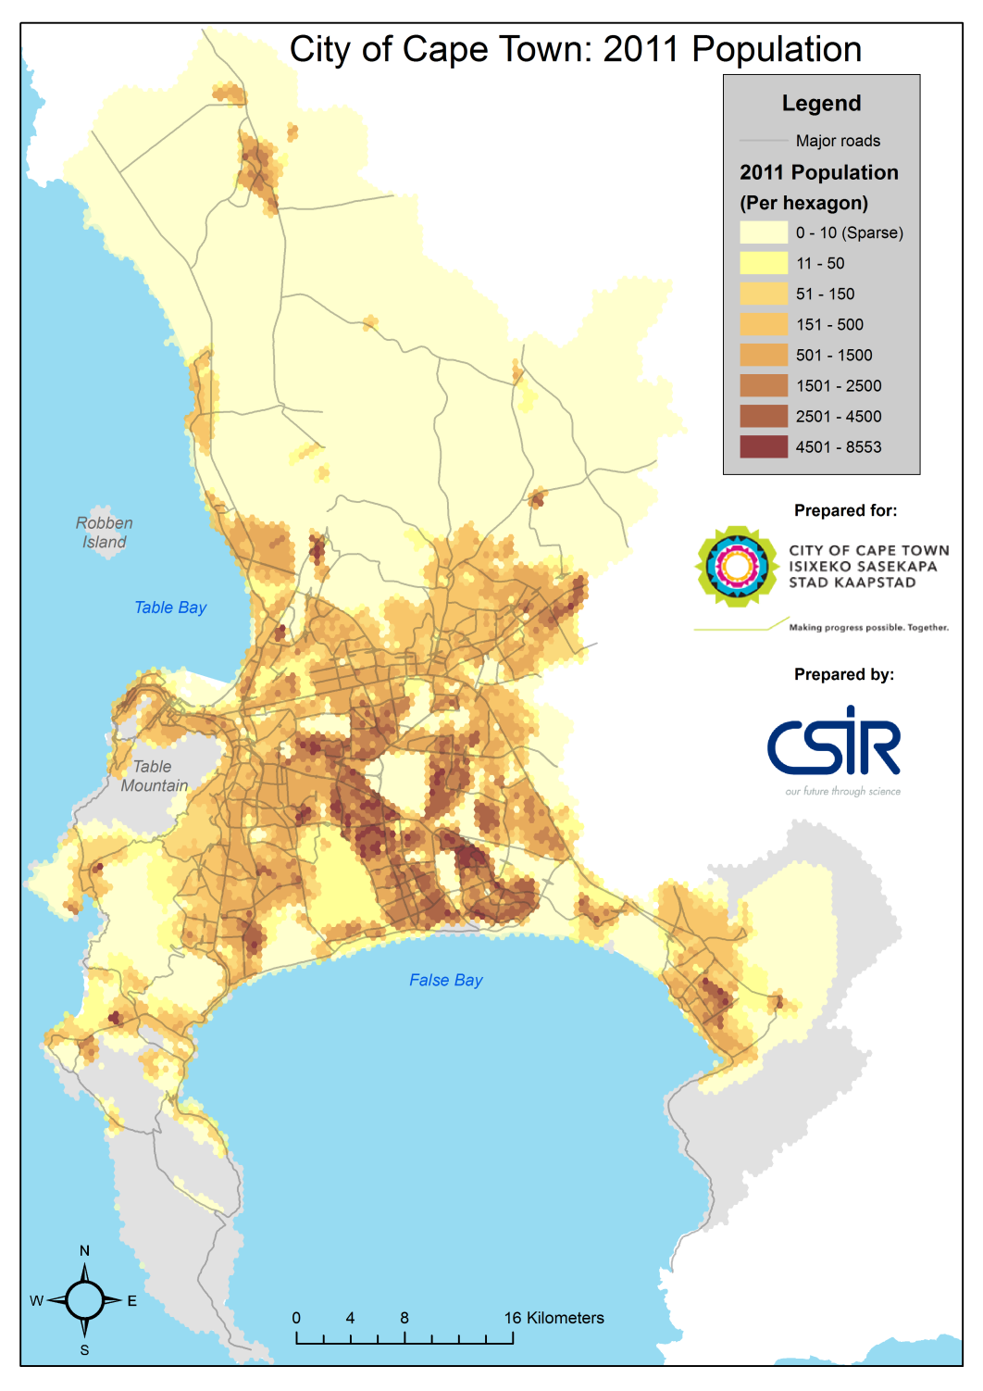
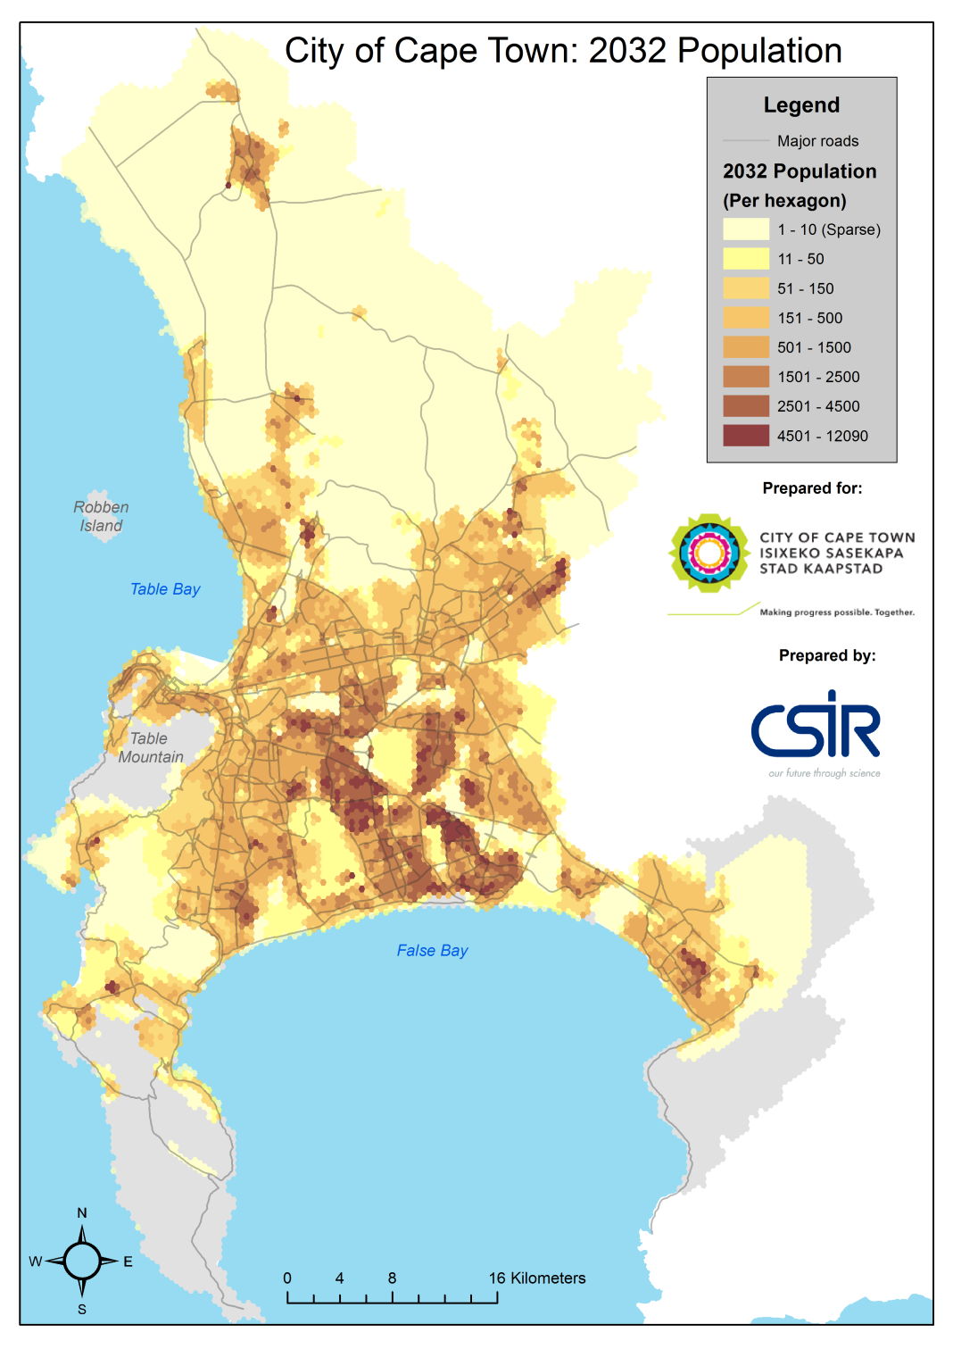
Population Demand
High growth areas
Thank you
3 664 445
People
4 466 969
People
(Projected)

Slide 9
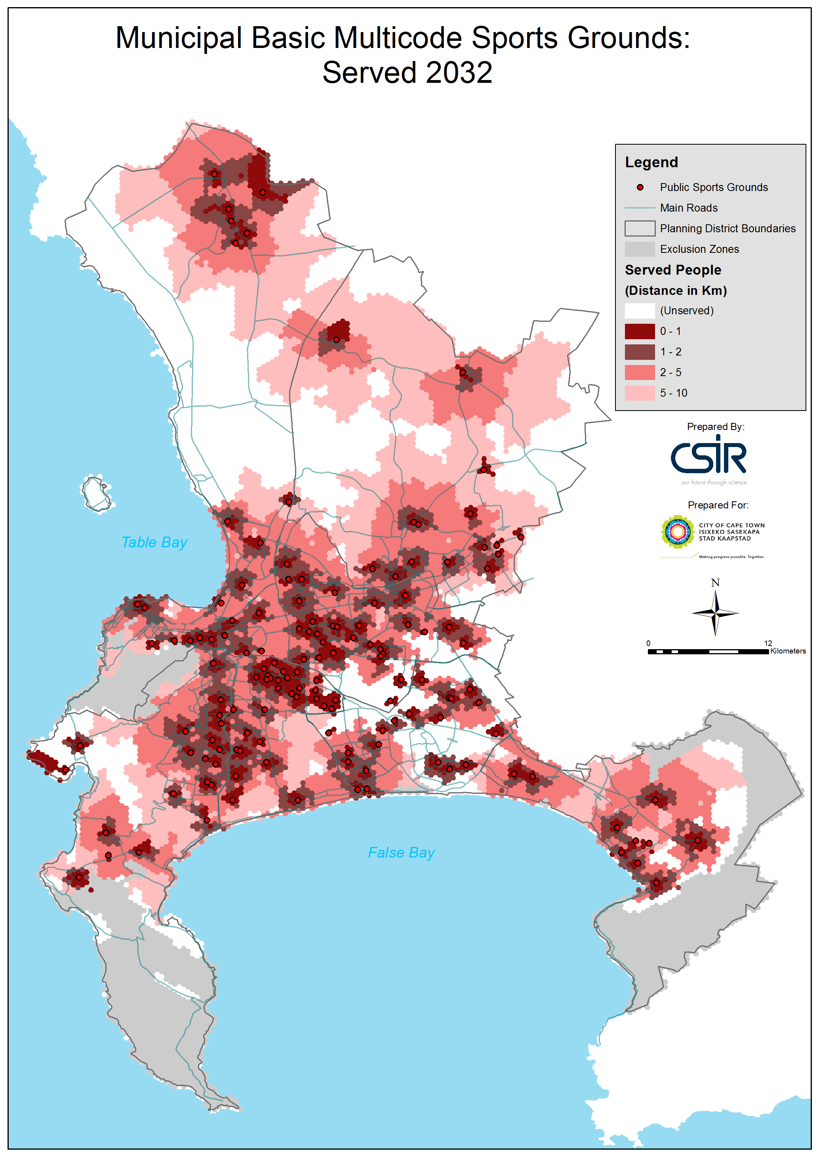
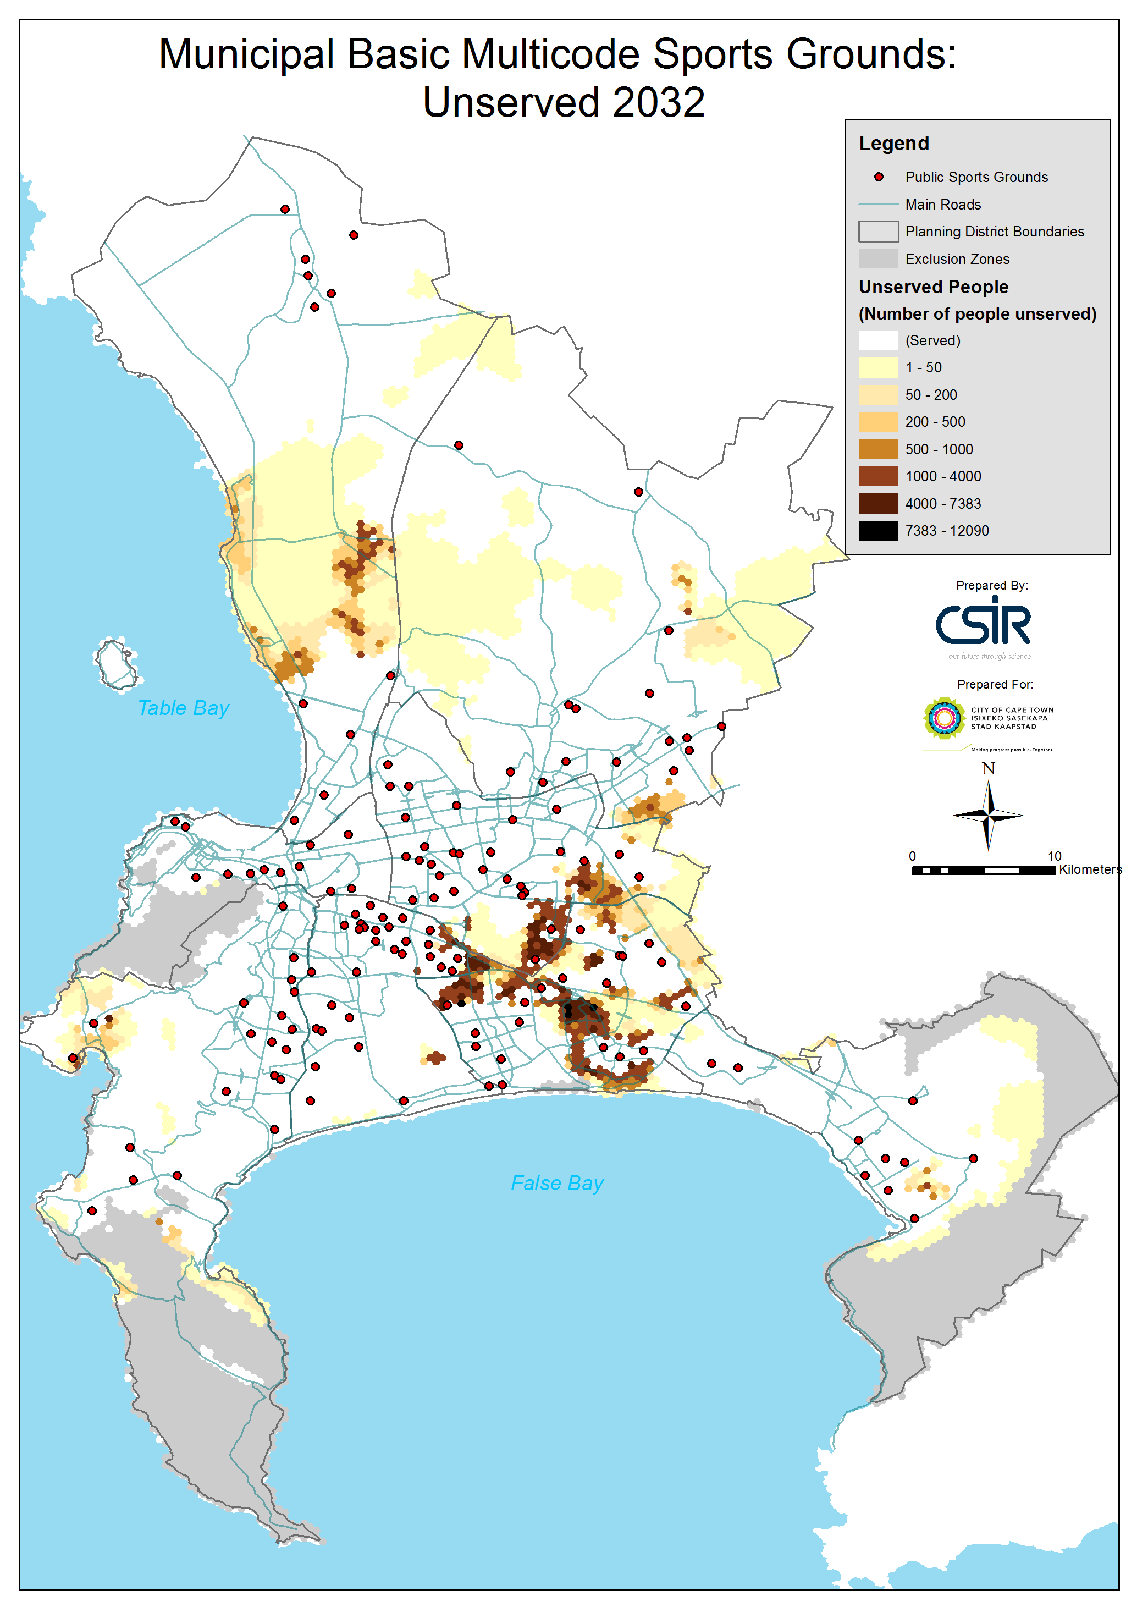
Municipal multicode sports grounds- Served and Unserved 2032
(Constrained by distance (10km) & capacity)
Municipal Multi - Code Sport Facilities
79% Served

Slide 10
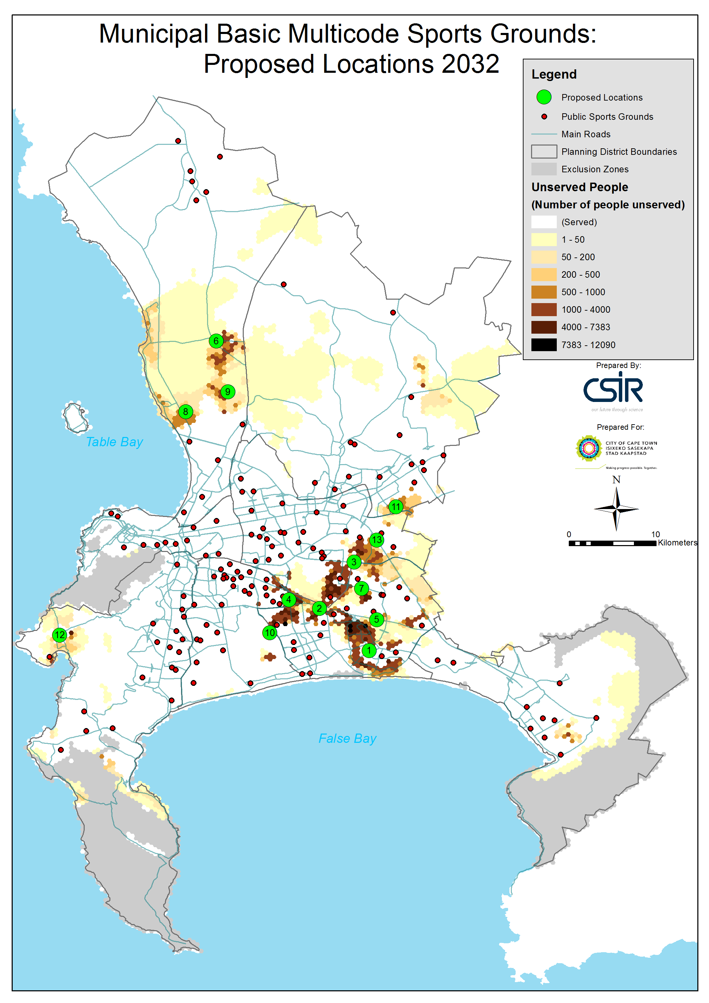
Municipal Multicode Sports Grounds:
Potential New Locations for 2032

Slide 11
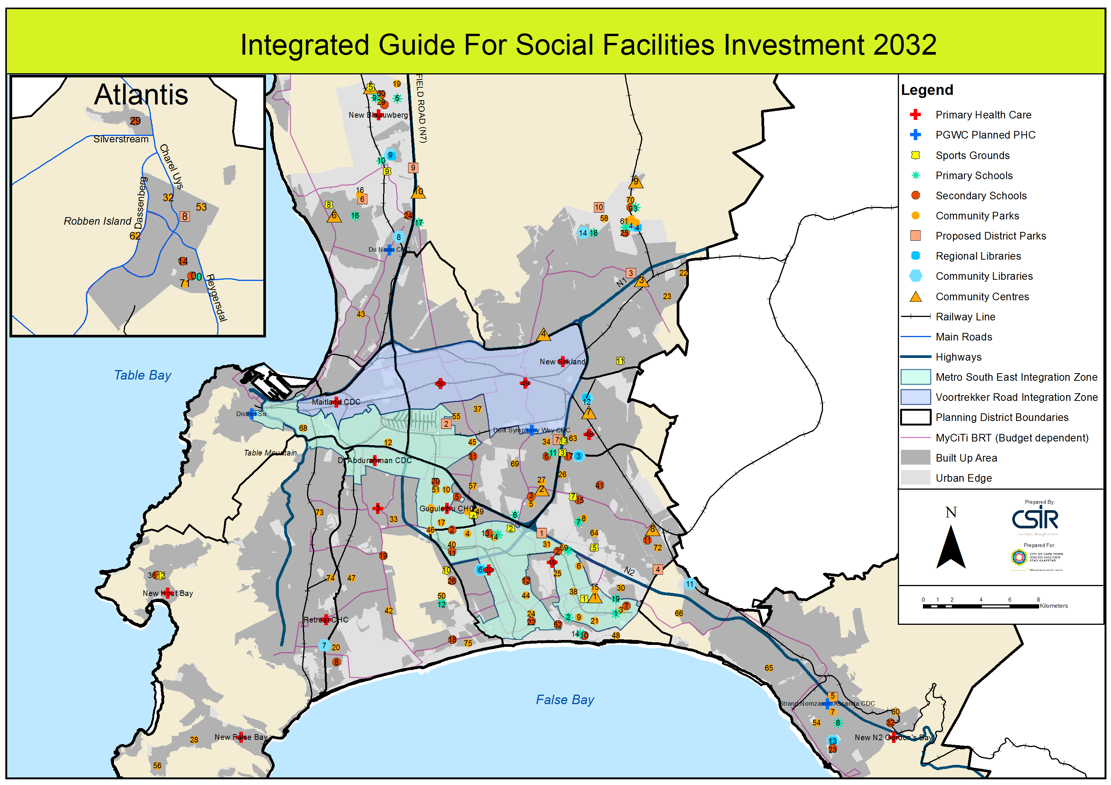
Overall Social Facility Investment Guide 2032

Slide 12
CAPITAL BUDGET - EFF BASE ( COMMUNITY SERVICES)
EFF Base allocation limits access to USDG funding due to counter-funding requirements

Slide 13
Community Services Capital Budget per Major Fund Source

Slide 14
2014/15 CAPITAL BUDGET per MAJOR FUND SOURCE
Department | CGD | CRR | EFF | REVENUE | Grand Total
Projects, Strategy & Support |  |  |  | 266 990 | 266 990
City Parks | 43 799 028 | 19 755 601 | 9 752 752 | 268 921 | 73 576 302
Sport, Recreation & Amenities | 52 865 427 | 7 380 648 | 31 902 029 | 25 506 | 92 173 610
Library & Information Services | 47 901 152 | 15 146 010 | 18 963 252 | 6 443 584 | 88 453 998
 | 144 565 607 | 42 282 259 | 60 618 033 | 7 005 001 | 254 470 900
 | 57% | 16% | 24% | 3% | 100%
 |  |  |  | 2015/16 | 150 329 404
 |  |  |  | 2016/17 | 126 508 714
Cemetery Development
2015/16 | 20 824 392
2016/17 | 19 304 213

Slide 15
STAFF ATTRITION COMMUNITY SERVICES
CoCT
+49%
ComServ
-23%

Slide 16
CAPITAL BUDGET: COMMUNITY FACILITIES
Principles endorsed by Portfolio Committee :
Only capital projects with no future operating budget requirements.
Only upgrades and extensions to existing facilities where current operating budgets are available.
Business improvements projects, such as synthetic pitches to replace traditional turf to reduce future operating costs and allowing better future utilisation.
Capital safety measures at facilities to reduce security charges.
More cost effective service delivery options such as the proposed integrated approach to facility provision.

Slide 17
CURRENT CITY APPROACH
Pro-active integrated planning, budgeting, implementation and management (optimisation)
Metropolitan, District, Integrated Zone and Local Area Planning – Khayelitsha, Mfuleni Urban Node.
Facility Level (City Directorates, External Funders, PAWC,) –Kuyasa Library, Du Doon North Integrated Facility.
Facility Level (Community Services Departments) Blue Ridge, Valhalla Park
Rationalisation project
Broad based action and mainstreaming
Quick wins
Improve “return on investment” / expanding of current revenue sources
Commercial opportunities
Leases/management agreements
Business improvements with the intent to save on operating budget
Partnerships/ volunteers / friends groups
Outsourcing
External funding (e.g. lotto)
Hardening of facilities / artificial pitches / automatic irrigation ext.

Slide 18
Integrated planning examples

Slide 19
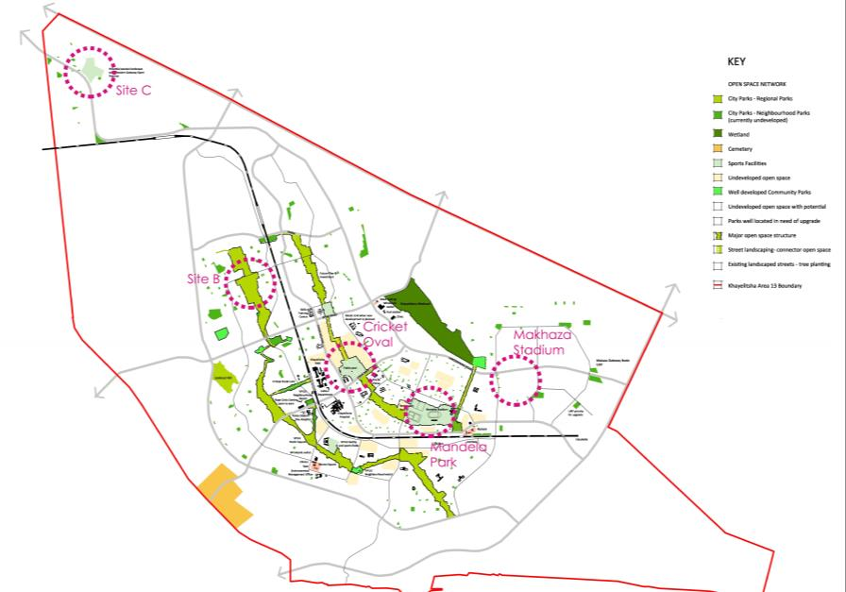
Khayelitsha

Slide 20
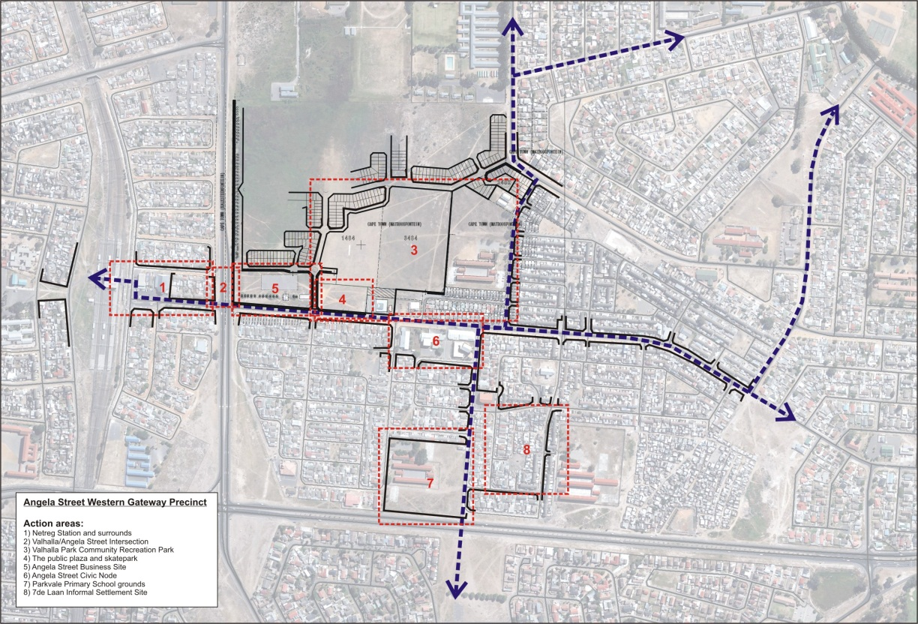
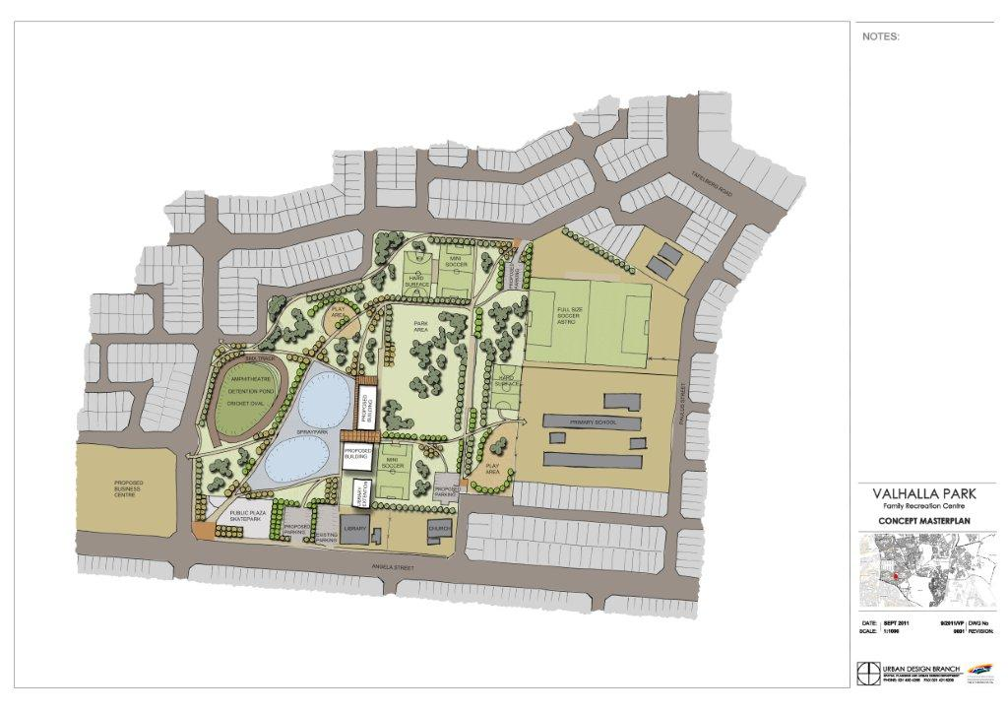
Valhalla Park: Integrated Facilities Planning
Lavistown Local Area Plan – Angela Street Precinct
Precinct 3
Valhalla Park Community Recreation Park
6
5
1
2
4
7
3

Slide 21
SUMMARY
Current City plan and options ?
Amenity demand / backlogs and growth
Funding capex & opex

Slide 22
Questions that need to be answered / Discussion points
What could be changed or added to the current City’s approach?
What institutional arrangements /capacity should be put in place / be created to manage multi functional integrated facilities?
Does the Integrated Human Settlement planning and funding model result in “Integrated Human Settlements”?
Are the current Social Amenities facility provision standards as currently set affordable and sustainable in the South African context? How should these standards be determined?
Could additional funding be made available for the provision and management of Library Information Services (underfunded by R500 million)?

